Slide 1




HEXAWARE CODE & RISE PROGRAM
Tech Innovators
“Bridging Today’s Talent with Tomorrow’s Technology”

Slide 2
Team Details
Tech Innovators-Team Name
Skill Navigator Application-Problem Statement
Team Members
Email ID
Jothika P K
jothikakamesh@gmail.com
Bhuvaneshwari K
buvibuvana509@gmail.com
Inbajothi A
jothiarumugam03@gmail.com
Karishma A
karishkareem2003@gmail.com

Slide 3
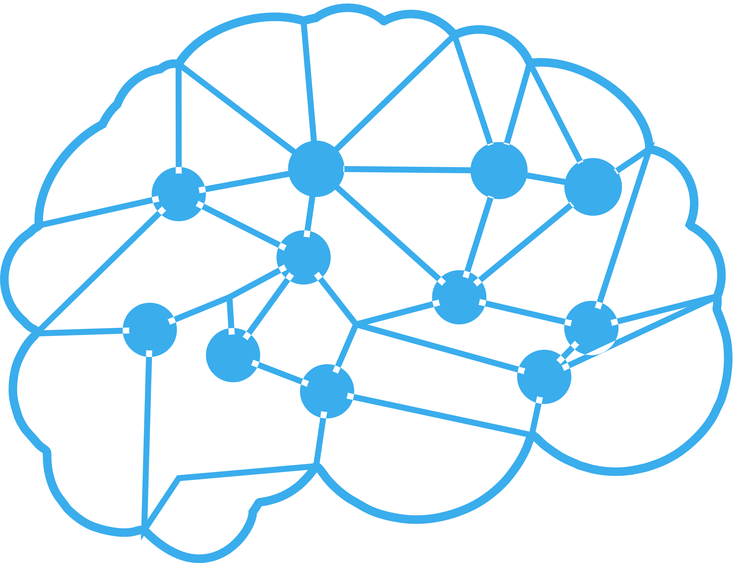
Impact/Potential Value of the Application
Impacts:
Personalized Learning: Tailored course recommendations and quizzes help users focus on areas most relevant to their career goals.
Educational Equity: Provides access to high-quality education and training resources regardless of geographic location or socioeconomic status.
Potential value:
Access to Talent: Employers can find qualified candidates with specific skills through the platform’s job and internship boards.
Workforce Development: By upskilling individuals, the platform can contribute to a more skilled and competitive workforce, which can drive economic growth.
Social Impact Projects: Include a section where users can apply their skills to social impact projects, providing real-world experience while contributing to meaningful causes. This could be done in collaboration with NGOs or social enterprises.

Slide 4
The Solution Proposed by your Team
Solution:
To make my skill navigator application stand out,
Our team proposed a solution by integrate an AI-powered adaptive learning engine that tailors content and feedback in real-time based on each user’s progress and evolving industry demands. Enhance accessibility and engagement by incorporating multilingual support with AI-driven translation and VR-based immersive learning environments for practical, hands-on experiences. Implement a blockchain-based credential system for secure and universally recognized certifications, and introduce a global peer mentorship network where users can collaborate on real-world projects, gaining mentorship and building professional connections. Finally, embed emotional intelligence (EQ) training alongside technical skills to foster well-rounded professionals ready for leadership roles..
Key Features:
-Skill Assessment tools
-Personalized Learning paths
-Progress Tracking
-Gamification
-Multi-Modal Content
-Mentorship and Training
-Multilingual Course Content

Slide 5
Technologies Used
Frontend:
o Framework: React.js
o Languages: JavaScript, HTML5, CSS3
o UI Components: Bootstrap
o Forms and Validation: Yup
Backend:
o Framework: Node.js with Express.js
o Languages: JavaScript (Node.js)
o Database: MySQL
o ORM: Seque lize (Node.js)
o Authentication: JWT (JSON Web Tokens)
AI and Data Processing:
o AI Frameworks: TensorFlow
o Languages: Python
o Data Processing: Pandas, NumPy
o Machine Learning: Scikit-learn
File Storage and Management:
o Google Cloud Storage
o File Upload Handling: Multer (Node.js)
Feedback System:
o Feedback Collection: Google Forms
o Data Analysis: Python (for NLP and sentiment analysis)
Reporting and Visualization:
o Reporting Tools: Jasper Reports / Apache POI (for Excel reports)
o Visualization: D3.js / Chart.js
o Export Formats: PDF, Excel
Deployment:
o Containerization: Docker
o Orchestration: Kubernetes
o CI/CD: Jenkins
o Hosting: Google Cloud Compute Engine
Security:
o Encryption: TLS
o Authentication and Authorization: JWT
o Vulnerability Scanning: OWASP ZAP

Slide 6
Gen AI Tool Utilization
Integrating AI powered solutions:
Chatbot Integration: An AI-powered chatbot can assist users in navigating the platform, answering questions, and providing instant support.
AI-Powered Tutoring: Incorporate an AI tutor that can explain complex topics, provide hints for quizzes, and offer additional practice material based on user needs.
AI-Driven Analytics: Analyze user performance data to identify strengths and areas for improvement, providing detailed feedback to guide further learning.
Content Summarization: AI-driven summarization tools that condense lengthy materials into digestible summaries, helping users quickly grasp key concepts.
AI-Based Mentor Matching: Implement an AI-driven system that matches users with mentors based on their learning style, personality, and specific goals to ensure the most effective mentorship experience.
AI-Driven Networking Suggestions: After course completion, the app could use AI to suggest relevant industry professionals, groups, or forums where users can network and continue their learning journey.

Slide 7
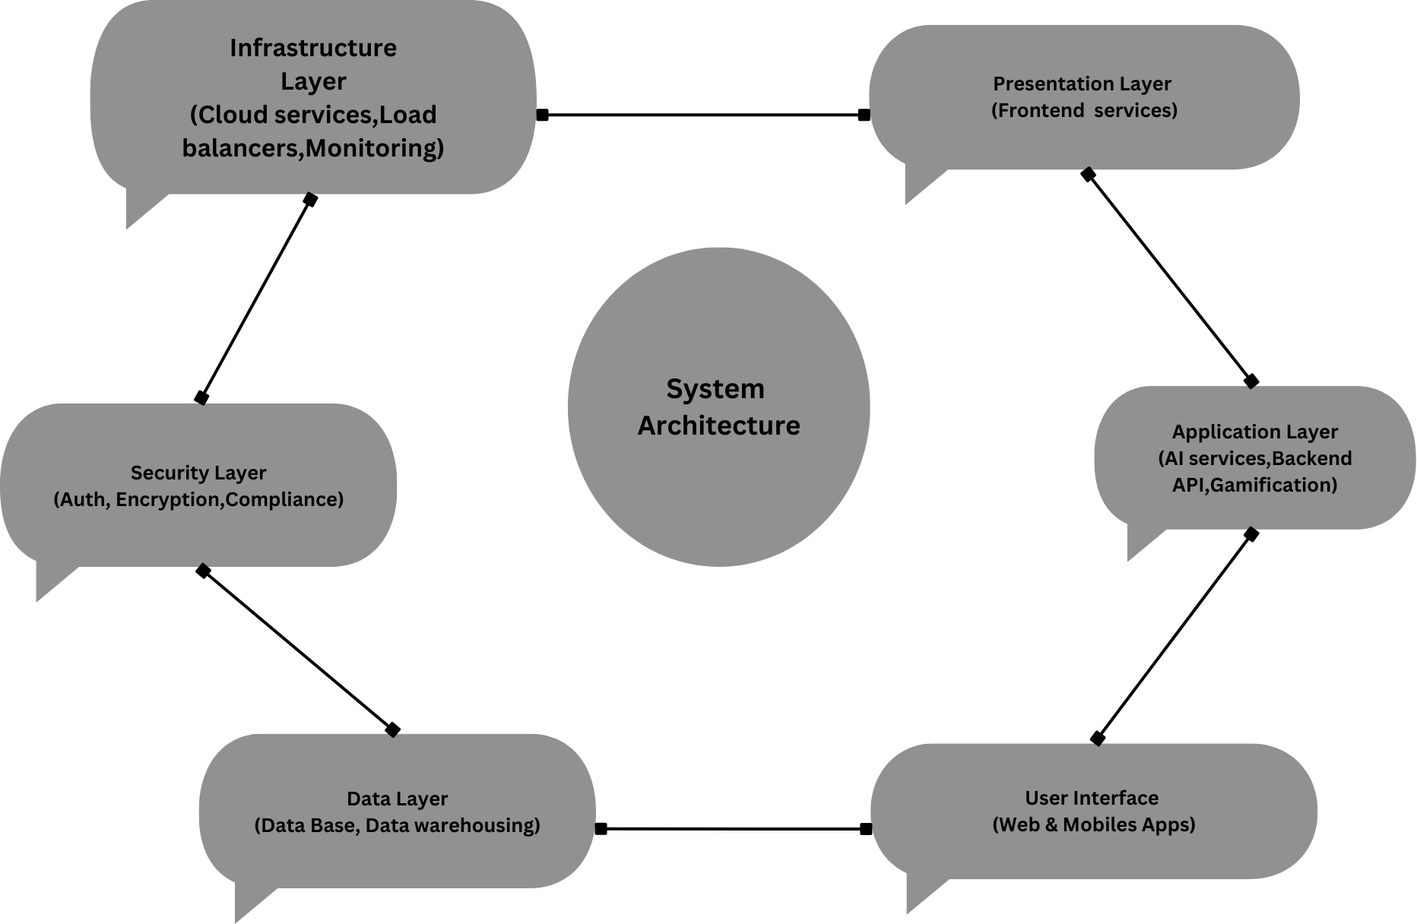
System Architecture, Functionalities and Design Diagram
Functionalities:
-Personalized Mentorship and Training
-Quizzes and Assessments
-Appreciations, Rewards, and Rankings
-Multilingual and Accessible Content
-AI Mentorship for Disabilities
-AI Assistants and Chatbots
-Automated Feedback and Progress Tracking

Slide 8
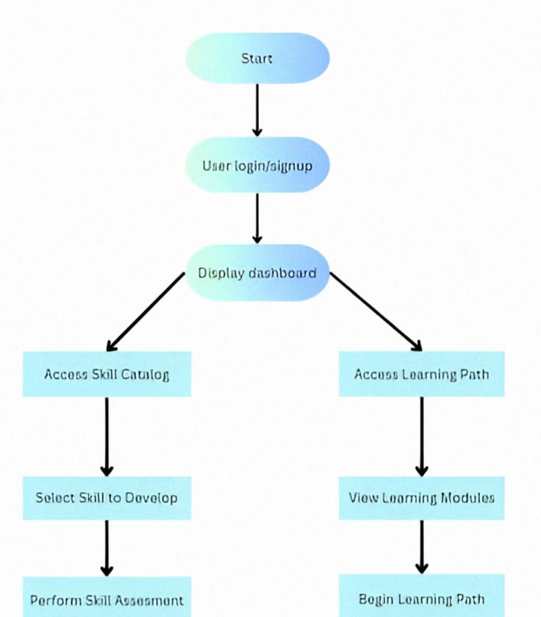
Functional Architecture

Slide 9
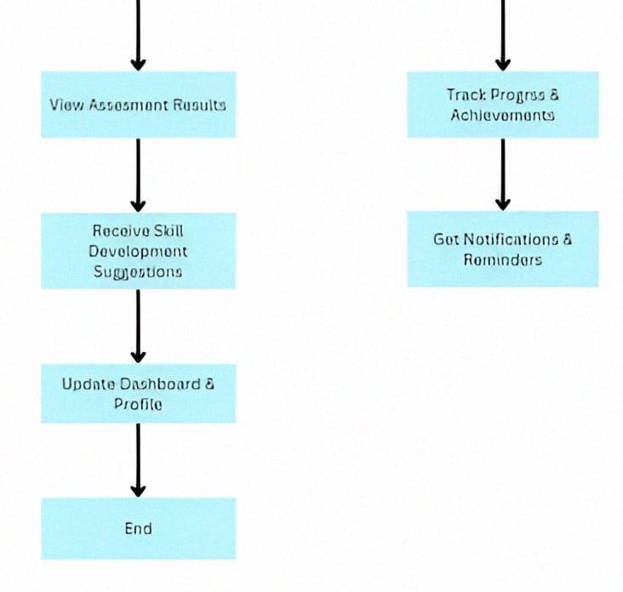

Slide 10
How it works
AI-Driven User Profiling & Skill Mapping:
NLP-Based Data Processing: User inputs are parsed using natural language processing (NLP) to extract key skills and experience, feeding into a graph-based skill ontology.
Real-Time Adaptive Learning Pathways:
Recommendation System: A collaborative filtering algorithm, combined with content-based filtering, delivering personalized learning modules, dynamically adapting based on user performance metrics.
AI-Augmented Mentorship:
AI Chatbots with Transformer Models: AI mentors are built on transformer models (e.g., GPT), enabling context-aware, natural language interactions and real-time problem-solving.
Automated Multilingual & Accessible Delivery:
AI Accessibility Features: Accessibility is powered by AI-driven features like adaptive UI, real-time speech recognition, and custom assistive tools based on user needs.

Slide 11
How It Works
Dynamic Assessment & Feedback System:
AI-Driven Adaptive Testing: The assessment engine uses Bayesian networks to dynamically adjust question difficulty, ensuring tailored challenge levels for each user.
AI-Powered Job Placement & Industry Integration
Hybrid Recommendation System: The job matching engine combines content-based and collaborative filtering to suggest internships and job roles, using real-time labor market data.
Scalable & Secure Infrastructure:
AI-Powered Intrusion Detection: A deep learning-based Intrusion Detection System (IDS) monitors network traffic and user behavior, providing proactive security against potential threats.

Slide 12
Innovation and Creativity
INNOVATION:
Emotional Intelligence (EQ) Monitoring: Track users' emotional engagement and stress levels during learning, offering personalized support or break suggestions to maintain well-being..
Real-Time Industry Projects: Partner with global companies to provide real-time project opportunities within the app, where users can work on actual industry challenges and gain practical experience.
Mindfulness and Resilience Programs: Provide optional modules focused on mindfulness, stress management, and building resilience to help users maintain mental well-being during their learning journey.
CREATIVITY:
Leveling System: Implement a leveling system where users “level up” as they acquire new skills, unlocking new content, badges, and mentorship opportunities
Community-Driven Skill Maps: Allow users to contribute to a global skill map, where they can share knowledge, resources, and insights about specific skills. This map can be used to find mentors, collaborators, or learning resources based on geography or industry.
Real-time Competitions: Host global skill competitions and hackathons where users can showcase their abilities, collaborate with others, and compete for prizes. These events can be aligned with industry trends and provide opportunities for users to get noticed by top companies.

Slide 13
Scalability, Performance and Security
Scalability:
Load Balancing: Distribute incoming requests across multiple servers to ensure no single server is overwhelmed.
Caching: Implement caching mechanisms to store frequently accessed data in memory to reduce database load.
Performance:
Concurrent User Capacity: Determine based on expected user load and perform stress testing to validate.
API Response Time: Should be less than 200 milliseconds for critical endpoints
Security:
Authentication and Authorization: Implement robust authentication and role-based access control (RBAC) to ensure users have the correct permissions.
Data Encryption: Encrypt sensitive data both in transit (using TLS)and at rest (using AES).
.

Slide 14
Best practices and industry standards followed
Best practices:
Skill Gap Analysis:
Regularly reassess users' skills and career goals to update their learning paths and suggest new areas for growth.
Inclusive Design:
Design courses and materials to be accessible for people with disabilities. Use AI to provide tailored support and adapt content for different learning needs.
Networking Opportunities:
Facilitate networking by creating virtual meetups and forums where users can interact with industry experts, peers, and potential employers.
Industry Standards:
Industry Expert Interaction: Facilitate networking and mentorship opportunities with industry experts through scheduled webinars and Q&A sessions.
Third-Party Integrations: Integrate with popular tools and platforms for additional functionality, such as calendar integrations for scheduling, or video conferencing tools for webinars and mentor sessions.

Slide 15
User Experience
Interactive Content:
Engaging content formats such as interactive videos, quizzes, and gamified elements that keep users actively involved in their learning journey.
Clear Progress Tracking:
Visual progress trackers and milestones that allow users to easily monitor their achievements, completed modules, and upcoming tasks.
User Feedback Integration:
Regular collection and analysis of user feedback to continuously improve the platform’s features, usability, and content.
Visual and Audio Learning Preferences:
Options to switch between visual, auditory, or text-based learning modes based on user preferences, enhancing the effectiveness of the learning experience.
Accessibility Features:
Go beyond basic accessibility by offering customizable interfaces for users with disabilities. For instance, integrating sign language interpreters via AI for hearing-impaired users or offering text-to-speech and speech-to-text features for visually impaired users.

Slide 16
Console Output Details
Figma Link: https://www.figma.com/design/i9qjOvHCZ3vrEUHTE4zQG9/Free-AI-Navigation-WebUI-Template---All-in-AI-Tools-(Community)?node-id=4-100&t=SVxLTQeRTXJhUfYR-1
Github Link: https://github.com/4043-Karishma/Tech-Innovators

Slide 17
Phase 1 - Judging Criteria
Solution Approach
Usage of Gen AI tools
Solution Feasibility
Technical Approach/Architecture Design
Innovation and Creativity
User Experience
Documentation and Presentation
Console Output

Slide 18
Thank You

